Slide 1
Software Development 3
Interfaces & Reuse Example

Slide 2
Interfaces and Reuse
We can use interface types to make code more reusable
In our 1st example we create a DataSet to find the average and maximum of a set of numbers

Slide 3
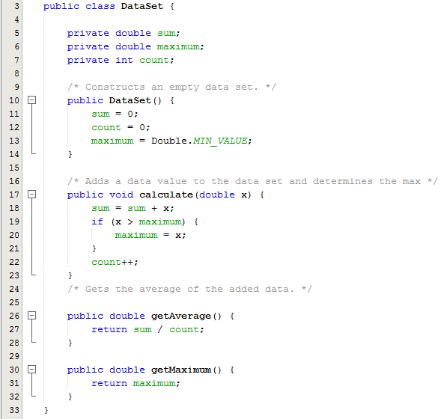
Example 1 - DataSet.java
3 member variables
default constructor
calculate method to keep a sum of the values and determine the maximum value
Two getter methods

Slide 4
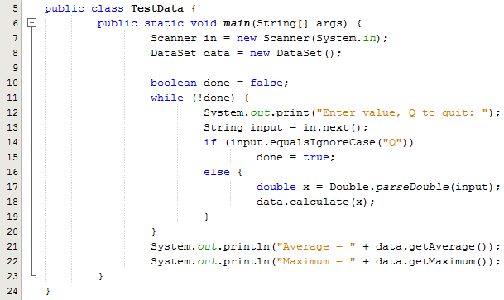
Example 1 - TestData.java
Test Class
Calls default constructor
Asks user to enter values or Q to stop
Calls the calculate method each time and passes on the value entered at keyboard
Prints out the average and the maximum of the values
Program Output:
Enter value, Q to quit: 1
Enter value, Q to quit: 2
Enter value, Q to quit: 3
Enter value, Q to quit: 4
Enter value, Q to quit: q
Average = 2.5
Maximum = 4.0

Slide 5
Interfaces
What if we want to find the average and maximum of a set of BankAccount balances?
Or perhaps we want to find the average and maximum of a set of Employee salaries?

Slide 6
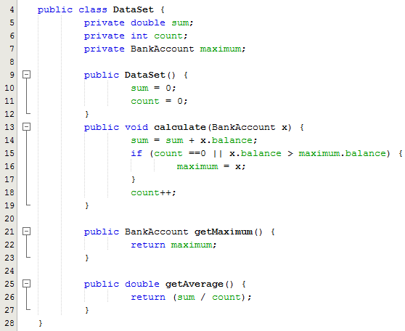
Example 2 – DataSet.java
In order for the DataSet class to work for comparing bankaccount balances we need to modify the DataSet class for BankAccount objects
Line 7: The member variable maximum is now of type BankAcount
Line 13: The parameter of the calculate method is now a BankAccount object reference
Line 21: The getMaximum method now returns an object reference of type BankAccount

Slide 7
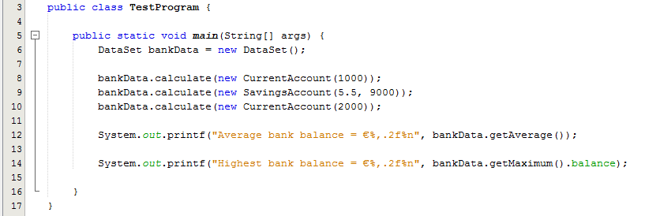
Example 2 – TestData.java
Test Class
Calls default constructor
3 calls to the calculate method where 3 object references of type BankAccount are passed in
Prints out the average and the maximum of the bank account balances
Program Output:
Average bank balance = €4,000.00
Highest bank balance = €9,000.00

Slide 8
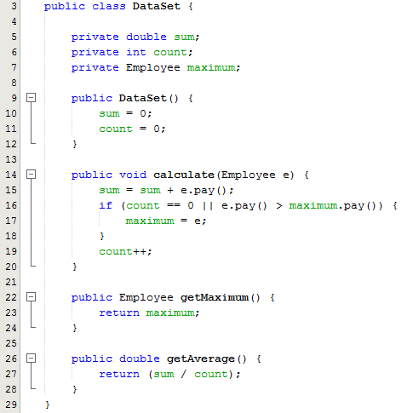
Example 3 – DataSet.java
Suppose we wanted to find the employee with the highest pay among a set of employees. We would need to modify the DataSet class again
Note the changes highlighted in red

Slide 9
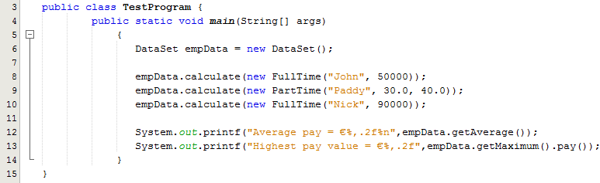
Example 3 – TestData.java
Test Class
Calls default constructor
3 calls to the calculate method where 3 object references of type Employee are passed in
Prints out the average and the maximum of the employees pay
Program Output:
Average pay = €47,066.67
Highest pay value = €90,000.00

Slide 10
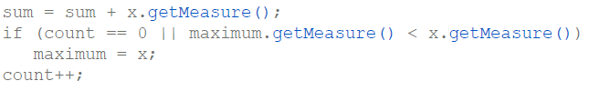
Using Interfaces for Reuse
The code for performing these operations is the same in all cases; details of measurement differ
Classes could agree on a method getMeasure that obtains the measure to be used in the calculations
We can implement a single reusable DataSet class whose add method looks like this:

Slide 11
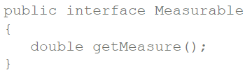
Using Interfaces for Reuse
What is the type of the variable x?
x should refer to any class that has a getMeasure() method
In Java, an interface type is used to specify required operations:
Interface declaration lists all methods that the interface type requires

Slide 12
Using Interfaces for Reuse
The name of an interface can be used to specify the type of a reference.
A reference variable declared using an interface name as its type can only reference instances of classes that implement that interface.
For example, the reference variable maximum shown below is declared using the name of an interface.
This variable can only reference instances of classes that implement the Measurable interface

Slide 13
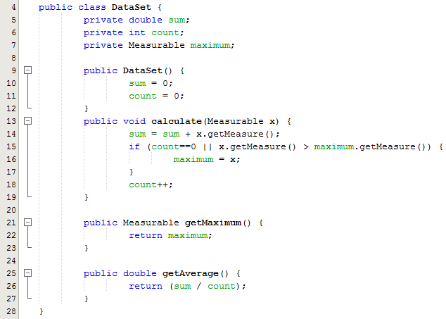

Example 4 – DataSet.java

Slide 14
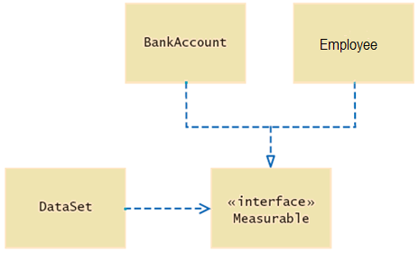
Implementing the Measurable Interface
UML Diagram of the DataSet class and the classes that implement the Measurable interface
UML notation:
Interfaces are tagged with a "stereotype" indicator «interface»
A dotted arrow with a triangular tip denotes the "is-a" relationship between a class and an interface
A dotted line with an open v-shaped arrow tip denotes the "uses" relationship or dependency

Slide 15
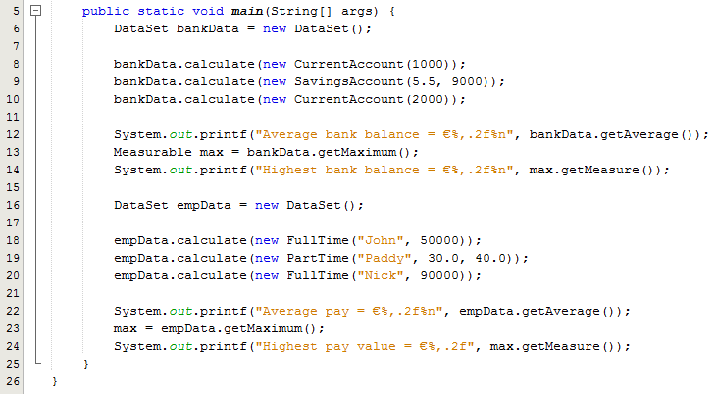
Example 4 – TestData.java
Program Output:
Average bank balance = €4,000.00
Highest bank balance = €9,000.00
Average pay = €47,066.67
Highest pay value = €90,000.00

